Slide 1
Your new Data Team
Stack Overflow Survey 2022
Carolina .
Shenya .

Slide 2
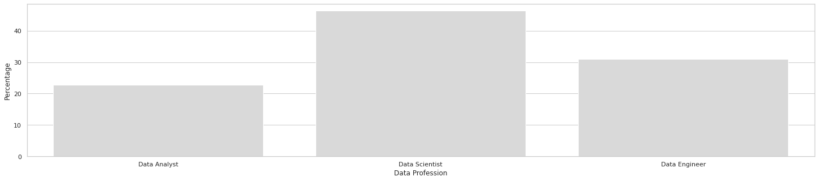
1076
/ 73,268
Data Analyst
Data Scientist
Data Engineer
~ 20%
~ 50%
~ 30%

Slide 3
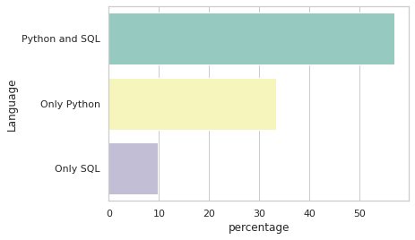
Python and SQL
57%
33%
10%

Slide 4
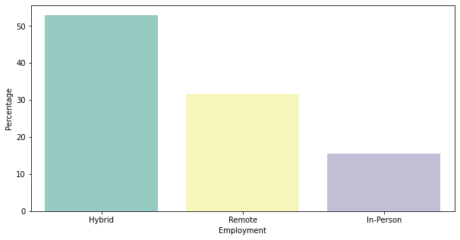
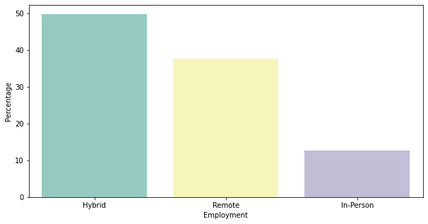
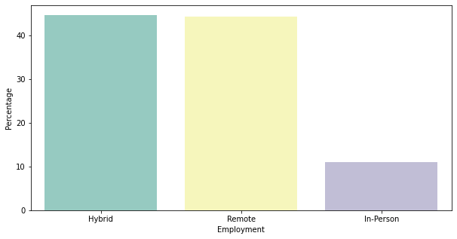
Employment
Hybrid is the preference
Data Engineers are the exception
Data Analyst
Data Scientist
Data Engineer
53%
38%
50%
32%
45%
44%
15%
12%
11%

Slide 5
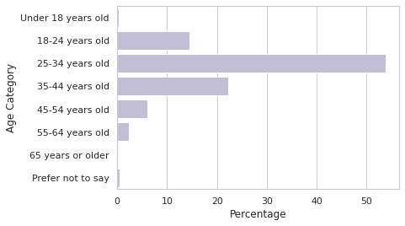
Age
< 1%
14%
54%
22%
6%
2%
< 1%
< 1%

Slide 6
Diversity and Inclusion

Slide 7
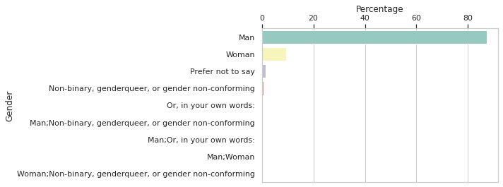
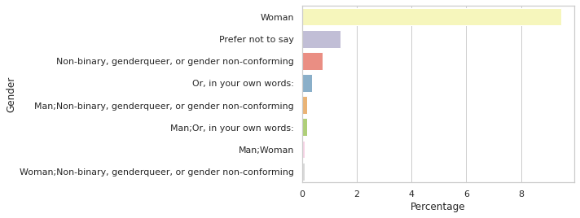
Gender
87% are men
Only 9% are women
4% other

Slide 8
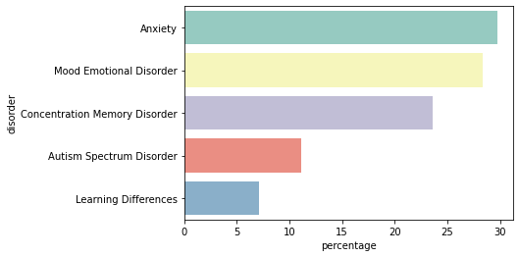
Mental Health
20%
30%
28%
24%
11%
7%

Slide 9
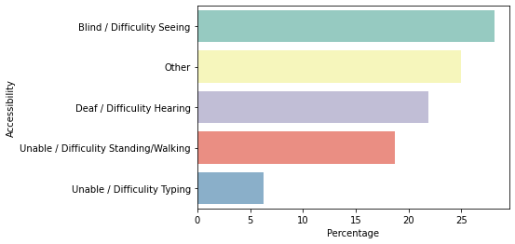
Accessibility
3%
28%
25%
22%
19%
6%

Slide 10


Recommendations
Including students - more insights
R
Mental health - prioritise!
Gender diversity
Accessibility
Multiple choice
Biased
Prefer not to say - interesting
Salaries
@caracego
@Zzzhenya

